Slide 1

ORM: Speaking the Database's Language, Effortlessly
A practical guide to understanding Object-Relational Mapping in Java — with real-world examples that make it click.

Slide 2


The Problem: Two Worlds Collide
☕ App Code (OOP)
Without a bridge, developers must hand-write SQL for every query, manually map results to objects, and risk SQL injection bugs — all just to do basic data operations.
Java — your code thinks in objects, classes, and methods.
🗄️ Database (Relational)
This friction is called the "impedance mismatch" — a classic pain point every developer eventually faces.
SQL, tables, rows, columns — the database thinks in structured sets.
⚡ The Mismatch
Bridging these two worlds manually is complex, repetitive, and error-prone.

Slide 3
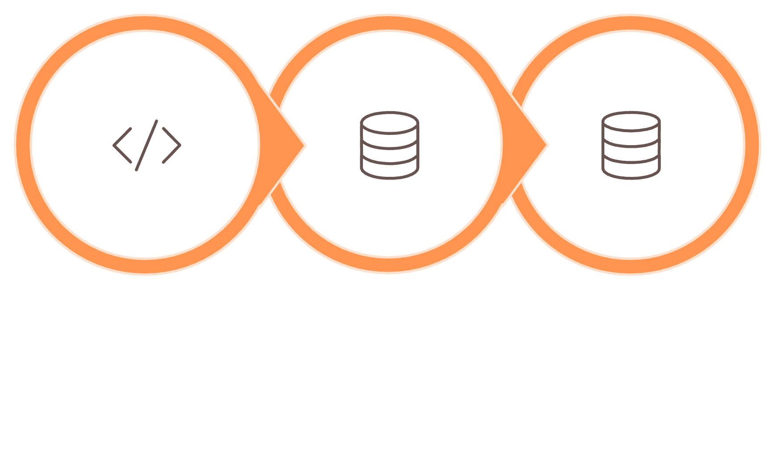
Enter ORM: The Translator
ORM (Object-Relational Mapping) is a technique that bridges the gap between your object-oriented code and the relational database — automatically.
Write Objects
ORM Translates
Store & Return
Map Objects → Tables
Auto-Generate SQL
Popular ORM
Think of It As...
You call student.save() — Hibernate writes INSERT INTO students... for you.
Hibernate (Java)
A smart translator: you speak Java, ORM speaks SQL.
A Java class becomes a database table. Each field becomes a column.

Slide 4


Real-World Example: Fetching Students
See the difference ORM makes with a simple, everyday task — retrieving all students from a database.
❌ Without ORM (Raw SQL)
✅ With ORM (Hibernate Example)
import java.sql.Connection;
import java.sql.DriverManager;
import java.sql.ResultSet;
import java.sql.Statement;
Connection conn = DriverManager.getConnection("jdbc:sqlite:school.db");
Statement stmt = conn.createStatement();
ResultSet rs = stmt.executeQuery(
"SELECT * FROM students WHERE active=1"
);
while (rs.next()) {
System.out.println(rs.getString(1) + " " + rs.getString(2)); // index guessing!
}
conn.close();
Session session = sessionFactory.openSession();
List<Student> students = session.createQuery(
"FROM Student WHERE active = true",
Student.class
).getResultList();
for (Student student : students) {
System.out.println(student.getName() + " " + student.getEmail());
}
Clean, readable, and Java-friendly — no SQL written. Hibernate handles the rest.
ORM code is shorter, safer, and easier to read. Changing the database engine? Just update the config — your code stays the same.
Manual connection, raw SQL strings, index-based access — fragile and hard to maintain.

Slide 5

Hibernate: Mastering Data Persistence
A deep dive into design patterns, loading strategies, caching, native queries, and the key annotations that power enterprise Java applications.

Slide 6


CORE CONCEPT
Object-Relational Mapping (ORM)
Hibernate bridges the gap between object-oriented Java code and relational databases. It maps Java objects to database tables — acting as a translator so your application can persist data without writing raw SQL directly.
Think of Hibernate as a smart middleman: your Java code speaks objects, your database speaks tables — Hibernate handles the conversation.

Slide 7
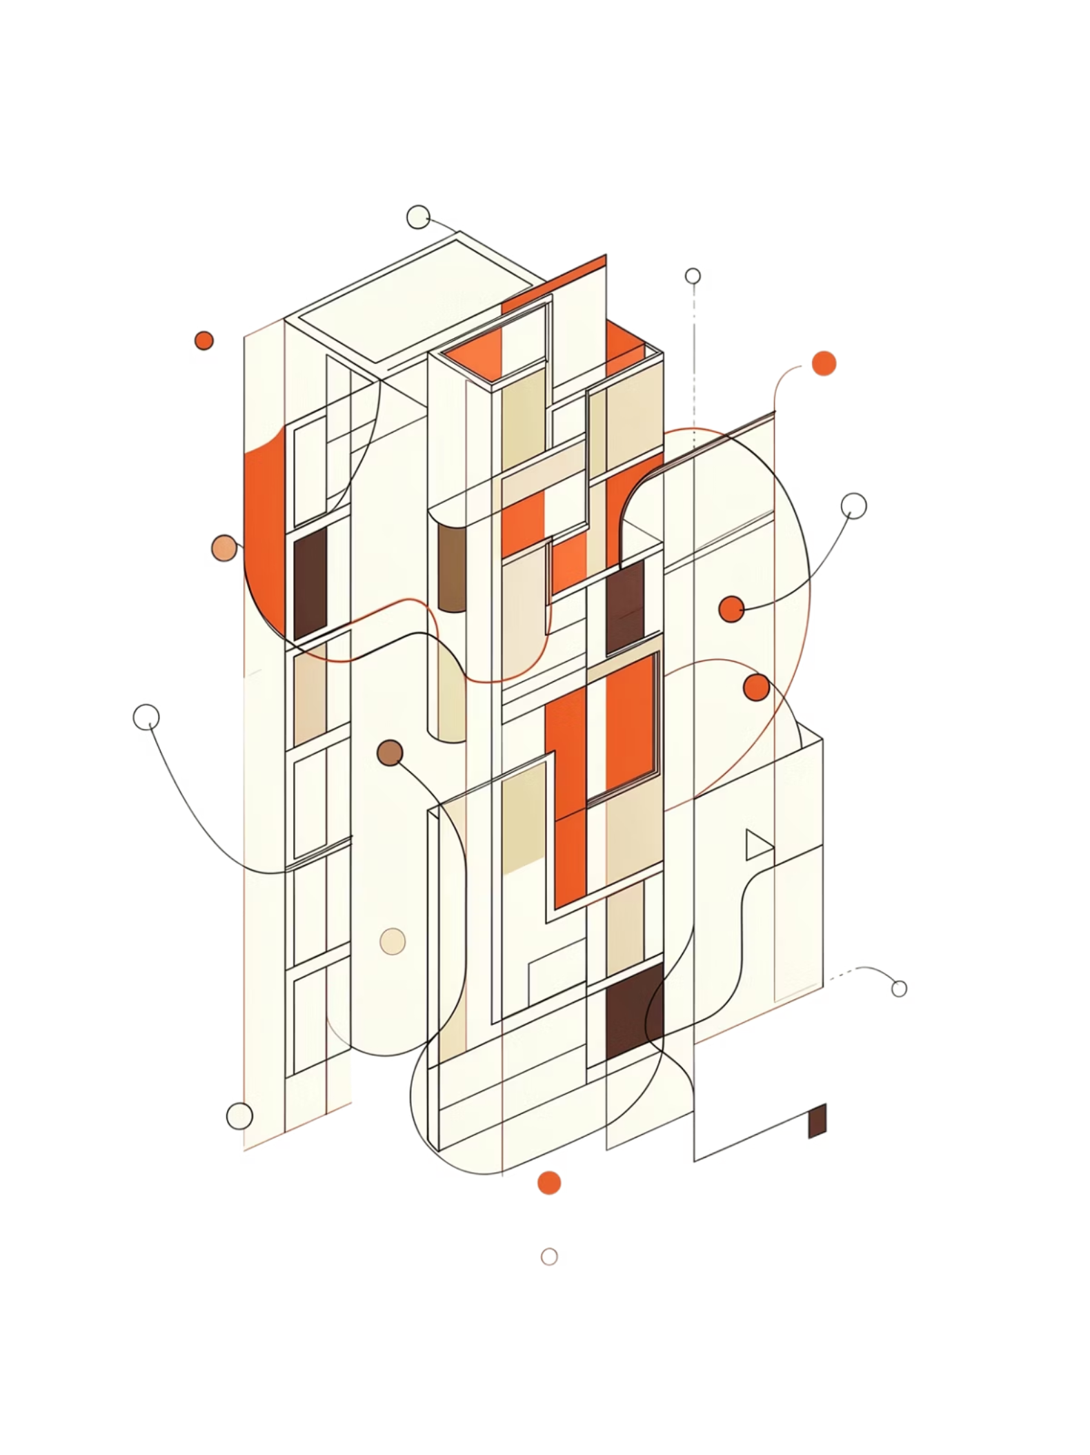
Design Patterns in Action
Hibernate's architecture is built on proven design patterns that promote clean, maintainable code.
Data Mapper Pattern
Hibernate abstracts direct database interactions via a clean API. Instead of writing SQL, you simply call session.save(customer) — Hibernate handles the rest.
Unit of Work Pattern
Manages transactions and ensures data consistency. Updating a customer's address and placing an order are committed or rolled back together — atomically.
Proxy Pattern
Hibernate uses proxy objects to support lazy loading. The actual data is fetched only when a method on the proxy is invoked, deferring expensive DB calls.

Slide 8
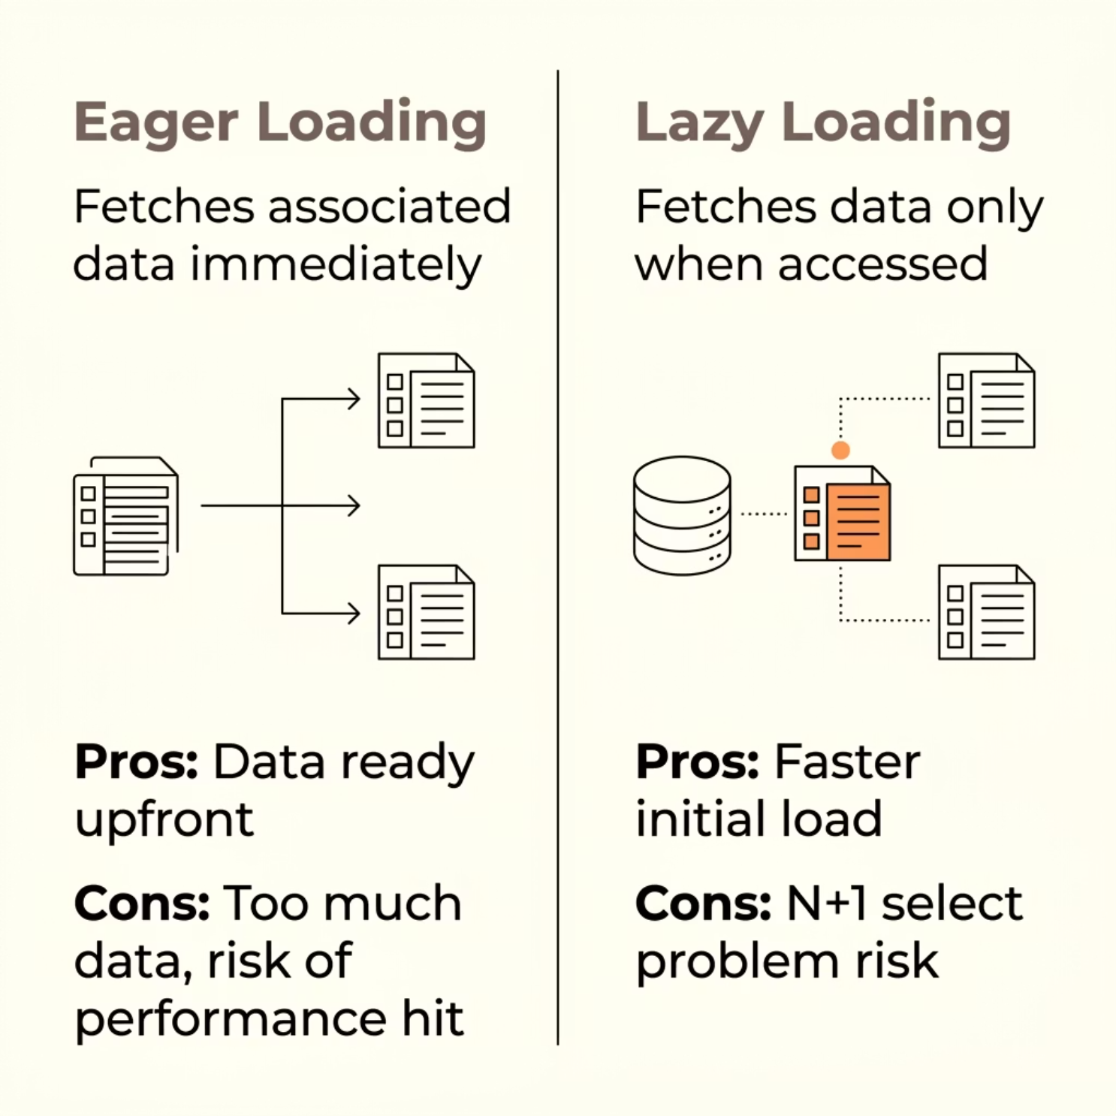



Loading Strategies: When to Fetch Data?
Choosing the right loading strategy is critical for application performance.
Eager Example: Loading a Customer object and immediately needing all their Orders — use FetchType.EAGER.
Lazy Example: Loading a Customer but only fetching Orders when you iterate them — use FetchType.LAZY. Watch for the N+1 problem!

Slide 9
Caching: Speeding Up Data Access
Hibernate offers a two-level caching architecture to drastically reduce database round-trips.
🗂️ First-Level Cache
🌐 Second-Level Cache
🔍 Query Cache
Scope: Single Session only. Automatically active — no configuration needed. Retrieving the same Product twice in one session returns the cached object.
Scope: Shared across all Sessions and SessionFactory. Requires explicit configuration (e.g., EhCache, Infinispan). Ideal for frequently accessed, rarely changed data.
Scope: Caches the results of HQL/Criteria queries. Works alongside the second-level cache. Best for queries with stable results and high repeat frequency.

Slide 10





Caching Strategies Explained
READ_ONLY
Immutable data only. Fastest strategy — no locking overhead.
NONSTRICT_READ_WRITE
Allows writes. No guaranteed immediate consistency. Best for most use cases.
READ_WRITE
Uses soft locks for consistency. Slightly slower but reliable for concurrent updates.
TRANSACTIONAL
Full ACID compliance. Slowest but safest for critical transactional data.

Slide 11


Native Queries: Direct Database Access
When Hibernate's HQL or Criteria API falls short, Native SQL gives you full control.
Use Case: Complex stored procedures, database-specific functions, or highly optimised SQL.
How: Use session.createNativeQuery("SELECT * FROM products WHERE ...")
Caution: Bypasses Hibernate optimisations and reduces portability across databases.
Use native queries sparingly — they tightly couple your code to a specific database dialect.

Slide 12
Key Hibernate Annotations: The Building Blocks
These annotations form the foundation of every Hibernate entity.
1
2
@Entity
@Table
Marks a Java class as a persistent entity mapped to a DB table.
@Entity public class Product { ... }
Specifies the exact table name in the database.
@Table(name = "products_catalog")
3
4
@Id
@GeneratedValue
Designates the primary key field of the entity.
@Id private Long id;
Configures primary key generation strategy (e.g., auto-increment).
@GeneratedValue(strategy = GenerationType.IDENTITY)

Slide 13
More Key Annotations: Relationships & Caching
@Column
@OneToMany / @ManyToOne
Maps a field to a specific column with constraints.
@Column(name = "product_name", nullable = false, length = 255)
Defines entity relationships. @ManyToOne @JoinColumn(name = "category_id") private Category category;
@ManyToMany / @OneToOne
@Cache
For complex relationships. Use @JoinTable for many-to-many mappings between entities like Student and Course.
Enables second-level caching on an entity.
@Cache(usage = CacheConcurrencyStrategy.NONSTRICT_READ_WRITE)

Slide 14

Building Efficient Applications with Hibernate
Hibernate is far more than a query tool — it's a comprehensive persistence framework.
Design Patterns
Data Mapper, Unit of Work, and Proxy patterns keep your code clean and maintainable.
Smart Loading
Choose Eager vs. Lazy loading based on your access patterns to avoid performance pitfalls.
Caching
Leverage L1 and L2 caches with the right strategy to minimise costly database round-trips.
Annotations
Master core annotations to build robust, well-mapped entities and relationships confidently.

